Slide 1
Motivation
Liberalization and deregulation of the markets → power systems must be competitive, high profitable and efficient
Steady increase of power demand but often slow growth of capacity and infrastructure
Uncertainty of generation level of renewables
Power systems are run closer to their maximum capacity margins
Danger of cascading blackouts increases due to stability problems
Important task in planning: Balancing profit and security
04.07.12
Dynamic Simulation for Power Networks and Risk-Based OPF
1

Slide 2
Tasks
Power system simulation
Develop a dynamic simulation that accurately models electricity networks
Public domain MATLAB based software “PSAT” as a basis
Define and implement risked-based OPF as a new approach to power system operation
Compare to security constrained OPF
Analyse results with the simulator
Calibrate model
05.10.12
Dynamic Simulation and Risk-Based OPF
2

Slide 3
Power System Analysis Toolbox (PSAT)
[Milano 2008]
Open source MATLAB toolbox for static and dynamic analysis of electric power systems
Why PSAT?
Many features: Power flow, CPF, OPF, SSSA, Time domain simulation
Dynamic models (up to VIII order synchronous generators, Turbine Governors (TG), Automatic Voltage Regulators (AVR), PSS, FACTS, Wind Turbines…)
Open source: Can be modified to meet specific requirements
Special interest in the time domain simulator: basis for later analysis
05.10.12
Dynamic Simulation and Risk-Based OPF
3

Slide 4
PSAT - Modifications
Generator outages during time domain simulation
Protection devices (automatic load shedding for under-frequency/voltage)
Island handling
Store and load operating points during simulation
Polynomial (ZIP) load model
“Breaking” routine
Implementation of IEEE 39-bus New England network
21 loads
10 order IV synchronous generators including TG’s and AVR’s
46 transmission lines
05.10.12
Dynamic Simulation and Risk-Based OPF
4

Slide 5
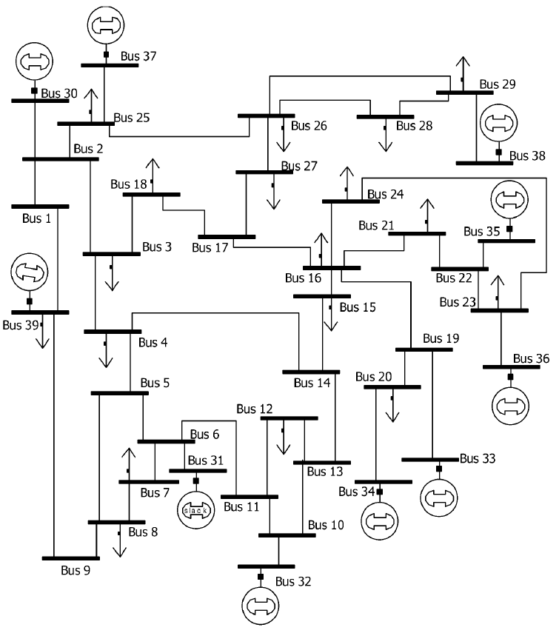
39-bus New England network
21 loads with a total demand of 6254 MW
46 trans-mission lines
11 tap changing transformers
10 order IV synchronous generators with max capacitance of 8404 MW
TG and AVR control devices
Individual cost parameters for every generator
05.10.12
Dynamic Simulation and Risk-Based OPF
5

Slide 6
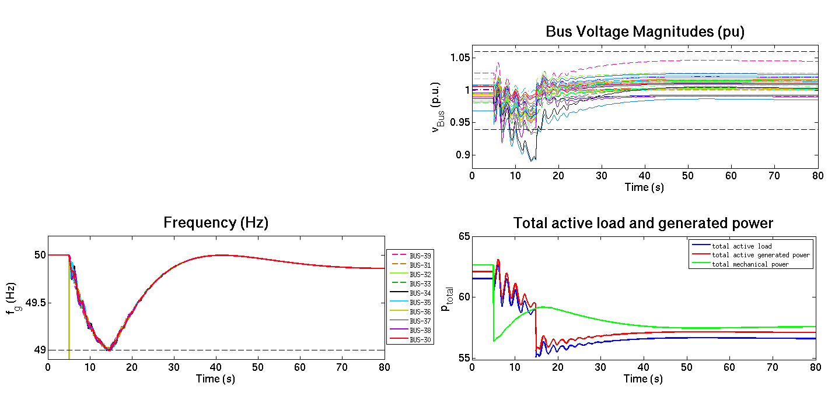
Simulator Example
IEEE 39-bus network
Generator 7 outage at 5 sec (10% of overall generation)
Loads: 70% impedance, 30% constant PQ
10% Load shedding at 14.87 sec
05.10.12
Dynamic Simulation and Risk-Based OPF
6

Slide 7
OPF
Optimal Power Flow: minimizing generation cost
generation cost
subject to
power flow equations
(reactive power likewise)
reference bus
generation limit constraint
voltage level constraint
thermal limit
Optimal Power Flow
05.10.12
Dynamic Simulation and Risk-Based OPF
7

Slide 8
OPF
Optimal Power Flow: minimizing generation cost
subject to
Optimal Power Flow
05.10.12
Dynamic Simulation and Risk-Based OPF
8

Slide 9
OPF
Optimal Power Flow: minimizing generation cost
subject to
Optimal Power Flow
05.10.12
Dynamic Simulation and Risk-Based OPF
9

Slide 10
SCOPF
[Capitanescu 2006]
Transform into SCOPF by adding post-contingency flow models
subject to
Base case constraints
Contingency constraints
$$∀c∈C$$
“Linking” equation, here
real power generation
Security Constrained Optimal Power Flow
05.10.12
Dynamic Simulation and Risk-Based OPF
10

Slide 11
SCOPF
[Capitanescu 2006]
Transform into SCOPF by adding post-contingency flow models
subject to
N-1 does not take into account more than one component failing
Infeasibility problems increase with number of contingencies
Does not account for likelihood of contingencies
Worst case scenario
Security Constrained Optimal Power Flow
05.10.12
Dynamic Simulation and Risk-Based OPF
11

Slide 12
[McCalley 2009]
RBOPF
no hard constraints on post-contingency line flows
subject to
instead:
penalise high line flows with severity index
Risk-Based Optimal Power Flow
05.10.12
Dynamic Simulation and Risk-Based OPF
12

Slide 13
[McCalley 2009]
RBOPF
Risk indicates the expected cost of the consequences associated with line overload
subject to
penalise high line flows with severity index weighted by their probability
additional risk index in the objective
Risk-Based Optimal Power Flow
05.10.12
Dynamic Simulation and Risk-Based OPF
13

Slide 14
[McCalley 2009]
RBOPF
Risk indicates the expected cost of the consequences associated with line overload
subject to
Risk-Based Optimal Power Flow
05.10.12
Dynamic Simulation and Risk-Based OPF
14

Slide 15
[McCalley 2009]
Severity Index
Severity defined as a function of line flow
Easiest and quickest implementation piecewise linear
$${severity}_{l,c}$$
$$1.0$$
$$90$$
$$100$$
$$flow (\%)$$
Overload severity
05.10.12
Dynamic Simulation and Risk-Based OPF
15

Slide 16
[McCalley 2009]
Severity Index
Severity defined as a function of line flow
Easiest and quickest implementation piecewise linear
$${sev}_{l,c}$$
$$1.0$$
$$90$$
$$100$$
$$flow (\%)$$
Overload severity
Severity is the sum of the severities of all contingencies plus the base case
05.10.12
Dynamic Simulation and Risk-Based OPF
16

Slide 17
Problems
Problem with all these models:
Security measure is relative
based on various assumptions, e.g.
SCOPF – ‘secure’ if all lines at 100% load
RBOPF – ‘secure’ if lines >>100%
Main problem with RBOPF:
Severity functions are arbitrary
??
$${sev}_{l,c}$$
$$1.0$$
$9$0
$$100$$
$$flow (\%)$$
05.10.12
Dynamic Simulation and Risk-Based OPF
17

Slide 18
Calibration
Solution: Calibrate severity functions to capture actual risk of a system
→ Question: What IS the actual risk?
Only one way to find out: Trip the line and see what happens.
→ How does the actual risk LOOK?
risk/hr
$/hr
$/risk
24.10.12
Dynamic Simulation and Risk-Based OPF
18

Slide 19
Calibration
Solution: Calibrate severity functions to capture actual risk of a system
→ Question: What IS the actual risk?
Only one way to find out: Trip the line and see what happens.
→ How does the actual risk LOOK?
→ How is the actual risk be DERIVED?
→ Simulator
→ develop “consequence tree” that visualises the actual impact of all considered contingencies
24.10.12
Dynamic Simulation and Risk-Based OPF
19

Slide 20
Consequence Tree
Tree for line contingencies 1-10
24.10.12
Dynamic Simulation and Risk-Based OPF
20

Slide 21
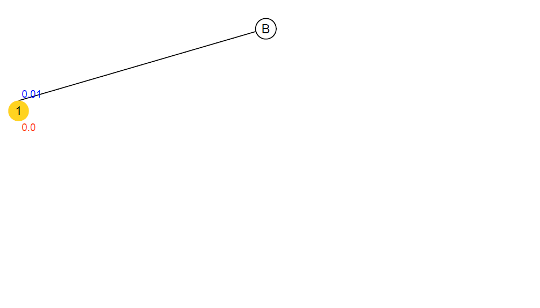
Consequence Tree
probability
amber nodes
are intermediate
severity (load shed)
Tree for line contingencies 1-10
24.10.12
Dynamic Simulation and Risk-Based OPF
21

Slide 22
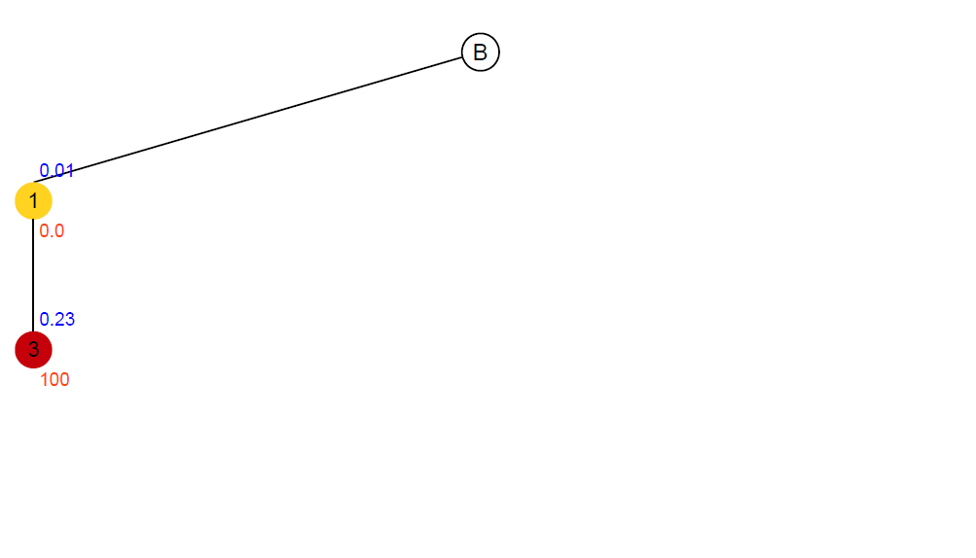
Consequence Tree
probability
red nodes
represent collapse
severity (load shed)
Tree for line contingencies 1-10
24.10.12
Dynamic Simulation and Risk-Based OPF
22

Slide 23
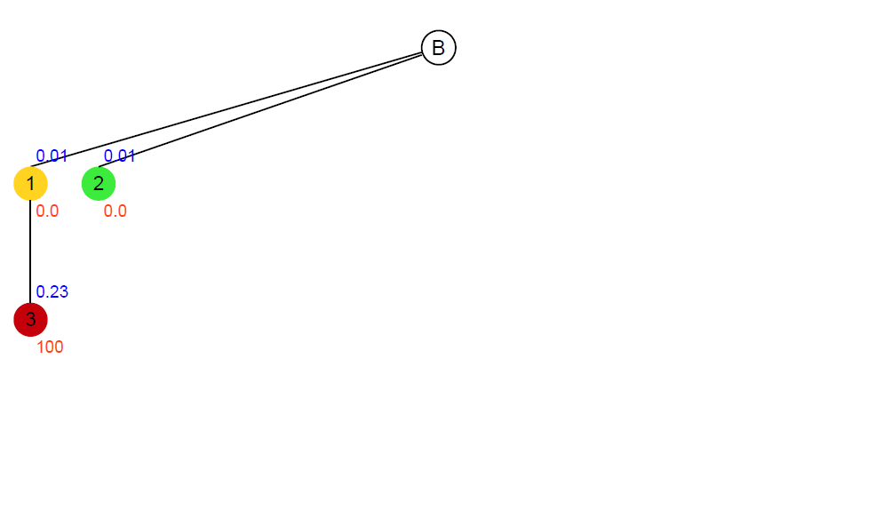
Consequence Tree
green nodes
are stable
Tree for line contingencies 1-10
24.10.12
Dynamic Simulation and Risk-Based OPF
23

Slide 24
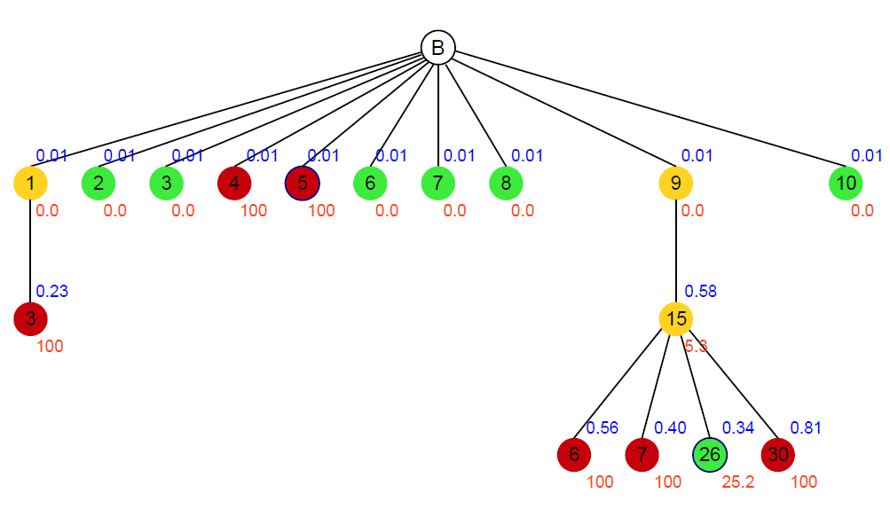
Consequence Tree
Tree for line contingencies 1-10
24.10.12
Dynamic Simulation and Risk-Based OPF
24

Slide 25
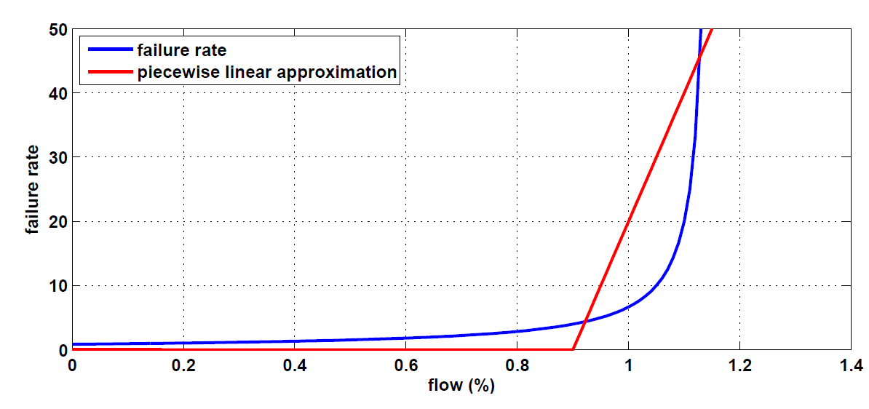
Tree-Risk
New measure of severity: Amount of shed load in each node
New approach to probability: Defined by the failure rate
Failure rate λ depends on flow
24.10.12
Dynamic Simulation and Risk-Based OPF
25

Slide 26
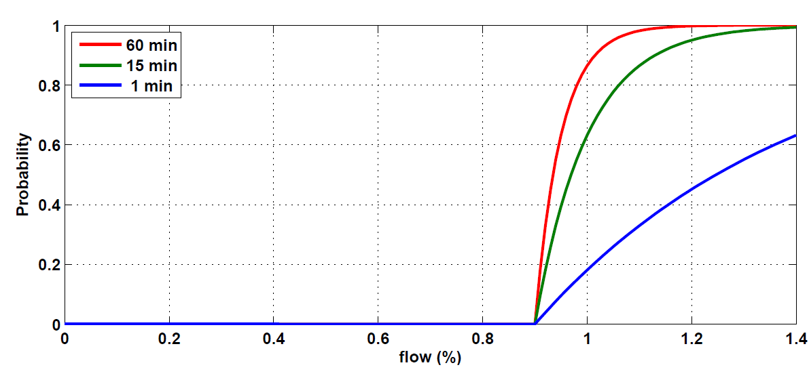
Tree-Risk
Assume exponential distribution
Probability depends on flow and λ as well as time Δt
24.10.12
Dynamic Simulation and Risk-Based OPF
26

Slide 27
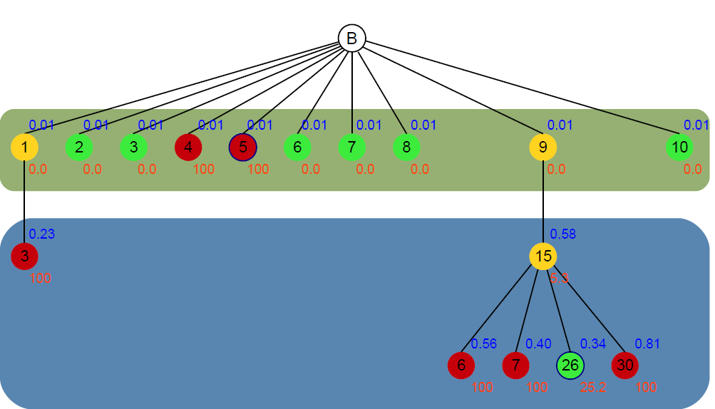
Probability Computation
Δt: considered time slot
15 min: reaction time (time in which the system is left on its own)
24.10.12
Dynamic Simulation and Risk-Based OPF
27

Slide 28
Contingency Risk Computation
Probability = Σ branch probabilities
Severity = accumulated load shed
risk_{c1} =
(0.01 · 0.23)
· 100
24.10.12
Dynamic Simulation and Risk-Based OPF
28

Slide 29
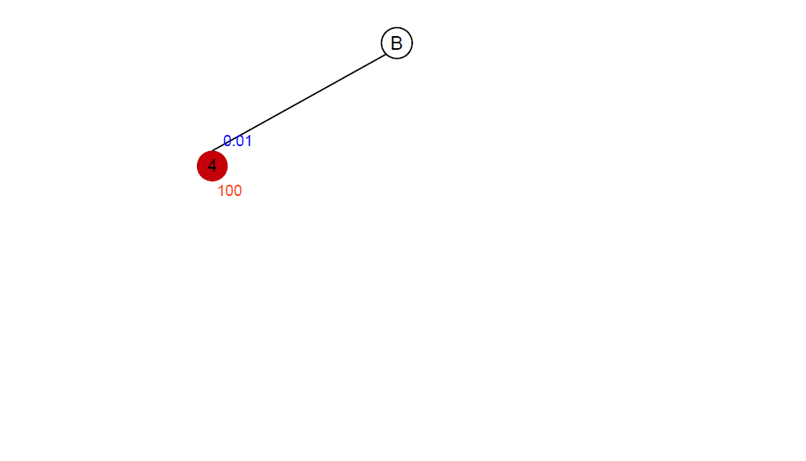
Contingency Risk Computation
Probability = Σ branch probabilities
Severity = accumulated load shed
risk_{c4} =
0.01
· 100
24.10.12
Dynamic Simulation and Risk-Based OPF
29

Slide 30
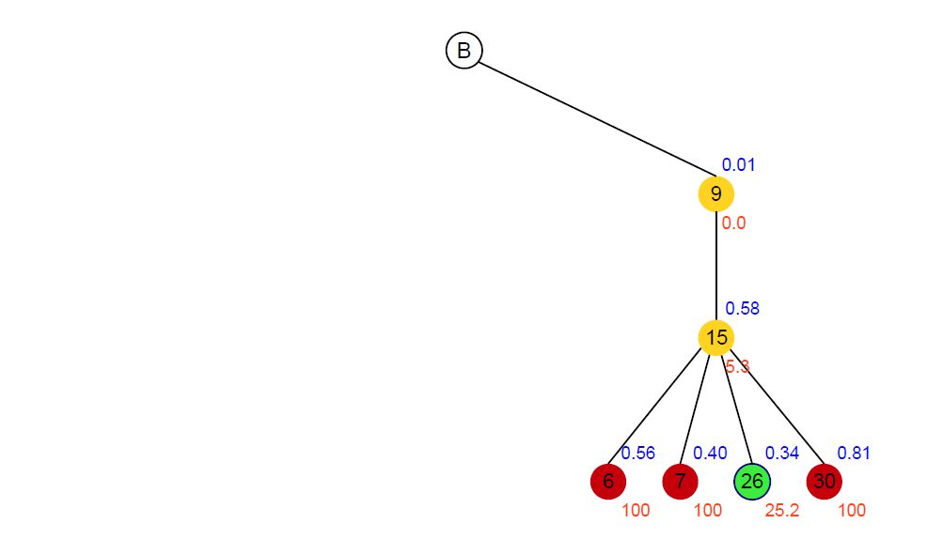
Contingency Risk Computation
Probability = Σ branch probabilities
Severity = accumulated load shed
risk_{c9} =
(0.01 · 0.58 · 0.56)
· 100
+ (0.01 · 0.58 · 0.40) · 100
+ (0.01 · 0.58 · 0.34) · 25.2
+ (0.01 · 0.58 · 0.81) · 100
24.10.12
Dynamic Simulation and Risk-Based OPF
30

Slide 31
Contingency Risk Computation
24.10.12
Dynamic Simulation and Risk-Based OPF
31

Slide 32
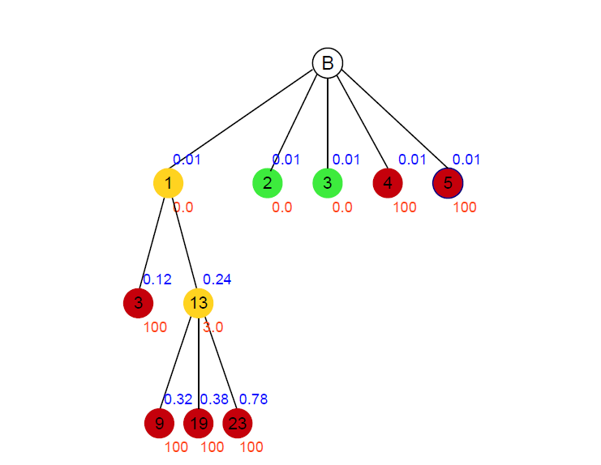
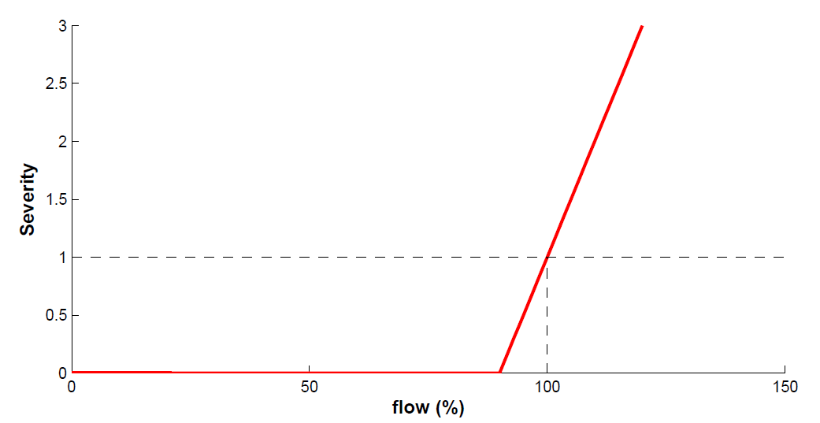
Results
Not calibrated
Risk is estimated wrong
 | risk^{RBOPF} | risk^{tree}
#1 | 0 | 0.471
#2 | 0 | 0
#3 | 0 | 0
#4 | 0 | 0.995
#5 | 0 | 0.995
24.10.12
Dynamic Simulation and Risk-Based OPF
32

Slide 33
Calibration of the RBOPF Model
SOLVE
RBOPF
adjust
severity functions
„=“ ?
solution
COMPUTE
TREE
24.10.12
Dynamic Simulation and Risk-Based OPF
33

Slide 34
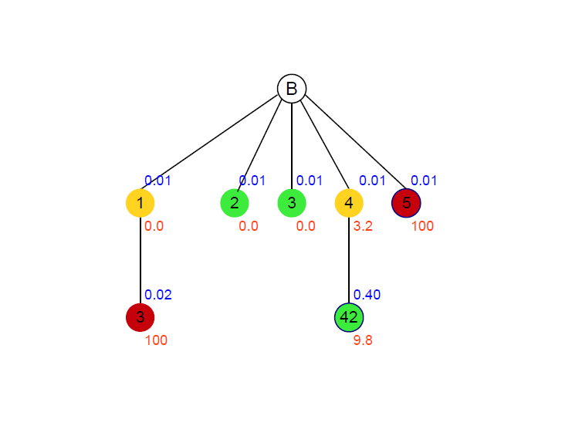
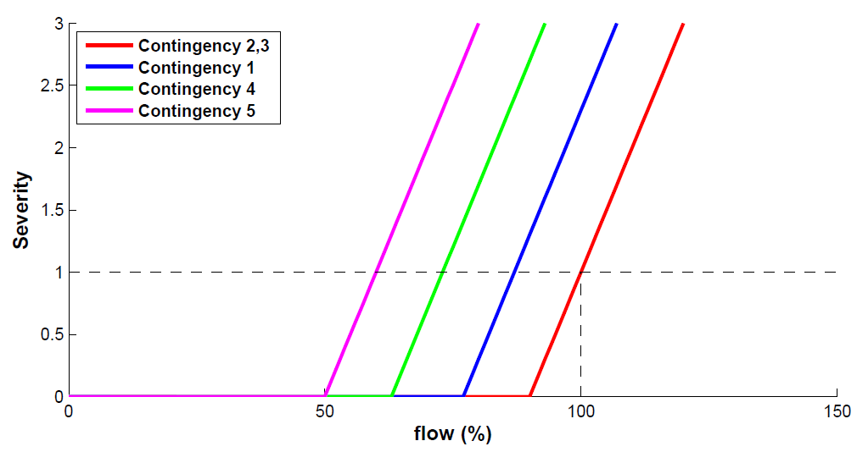
Results
Calibrated
Risk is estimated better
 | risk^{RBOPF} | risk^{tree}
#1 | 0.097 | 0.018
#2 | 0 | 0
#3 | 0 | 0
#4 | 0.184 | 0.039
#5 | 0.287 | 0.995
24.10.12
Dynamic Simulation and Risk-Based OPF
34

Slide 35
Summary and Outlook
Promising approach in operating power systems
The true consequences can be estimated
The more information is provided, the better the estimation of the actual risk
Best for systems with a small number of nodes
The relationship between the failure rate and the flow needs to be analysed better
An efficient algorithm for calibration needs to be found
24.10.12
Dynamic Simulation and Risk-Based OPF
35

